Slide 1

CAR RENTAL MANAGEMENT
ADVANCED WEB
PROGRAMMING
~ Suresh Sir
Project By: 22742 Kavita Kotia
22743 Rohan Mistry
22744 Malaika Raut

Slide 2
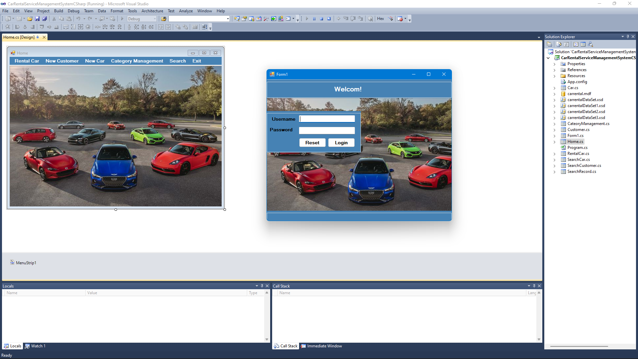
INTRODUCTION
The Online Car Rental System is easy to use, full-featured and flexible car booking, car listing and car rental web portal. It allows Administrators of this car rental website you can add new or change locations, vehicle pictures, rate card. The e-CarRental System provides complete functionality of listing and booking car.

Slide 3
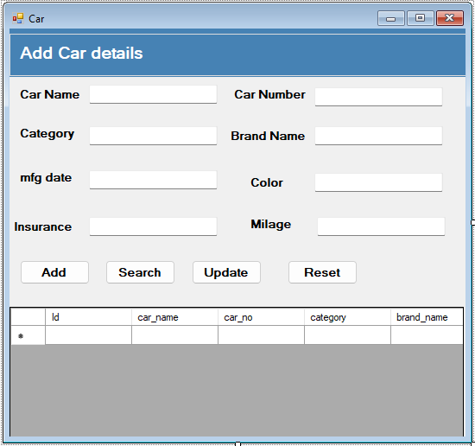
ABOUT THE PROBLEM
Car Rental System service will help users to book a car for some fee specified. Till now there was no clear web based UI to help the users to rent the vehicle. They had to manually rent the vehicle through their offices. It was a difficult task to manage rental vehicles. Keeping track of all the rental cars was a problem.

Slide 4
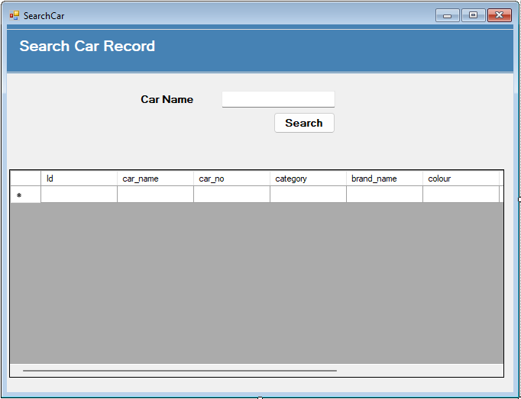
THE MAIN OBJECTIVE
This Car Rental System project will enable the user to rent a vehicle. The user shall login to the system and check for availability of cars. The user specifies a type of car and the journey date and time. The Car Rental System shall check for the availability of the car and rent the car to the customer. The tool is designed using ASP.net. All the data regarding the rental cars are stored in MySQL database. The user has to enter his name, address, phone details and check for the cars available for rent. The UI is very simple and the connectivity to back end is robust. The main advantage is that the user shall be able to choose a car depending on his budget. To produce a web-based system that allow customer to register and reserve car online and for the company to effectively manage their car rental business. To ease customer's task whenever they need to rent a car.

Slide 5
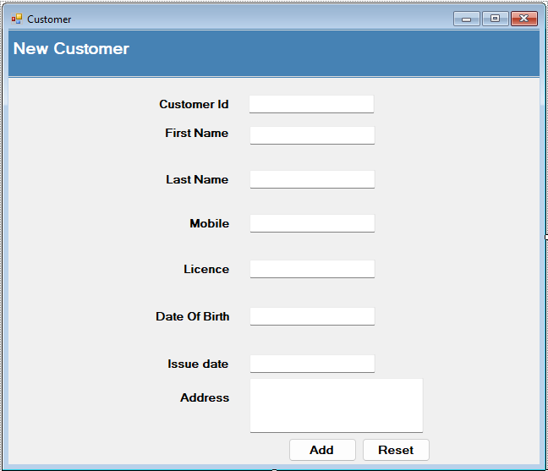
MODULES
Car Rental: This module shall have the data details regarding different type of cars and their booking dates, time etc.
User: This module shall have the details of the user like name address, phone number etc.

Slide 6
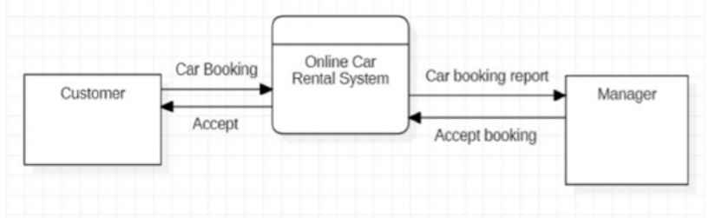
METHODOLOGY
Data Flow Diagram :
The Data Flow Diagram shown below illustrates the general structure of the system. It demonstrates how and what sorts of services the customer chooses, as well as the amount of admin engagement.

Slide 7
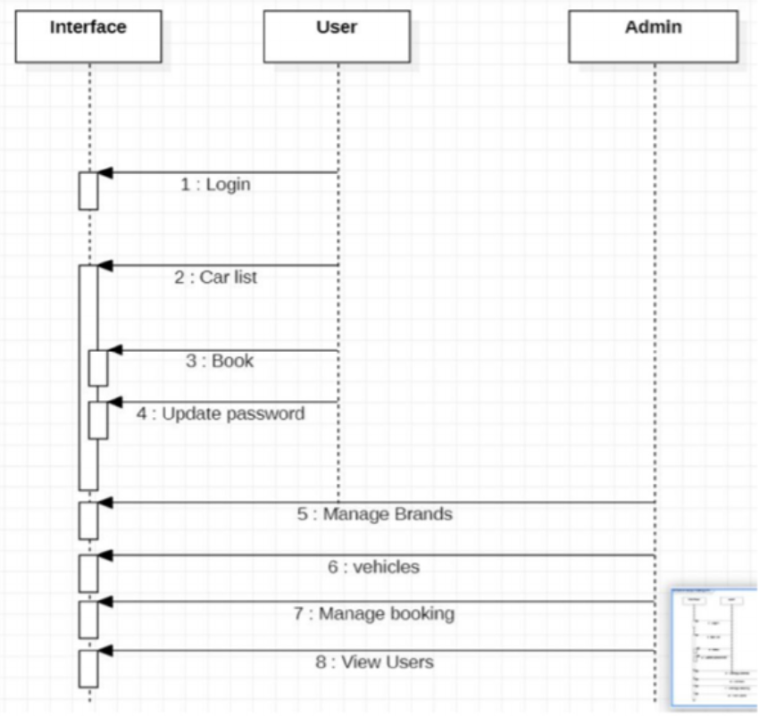
Sequence Diagram:
A sequence diagram is comparable to an interaction diagram because it explains how and in what order a faction of items interact. A sequence diagram focuses on lifelines or processes and objects that exist concurrently, and the messages transferred between them to complete a function before the lifeline terminates.

Slide 8
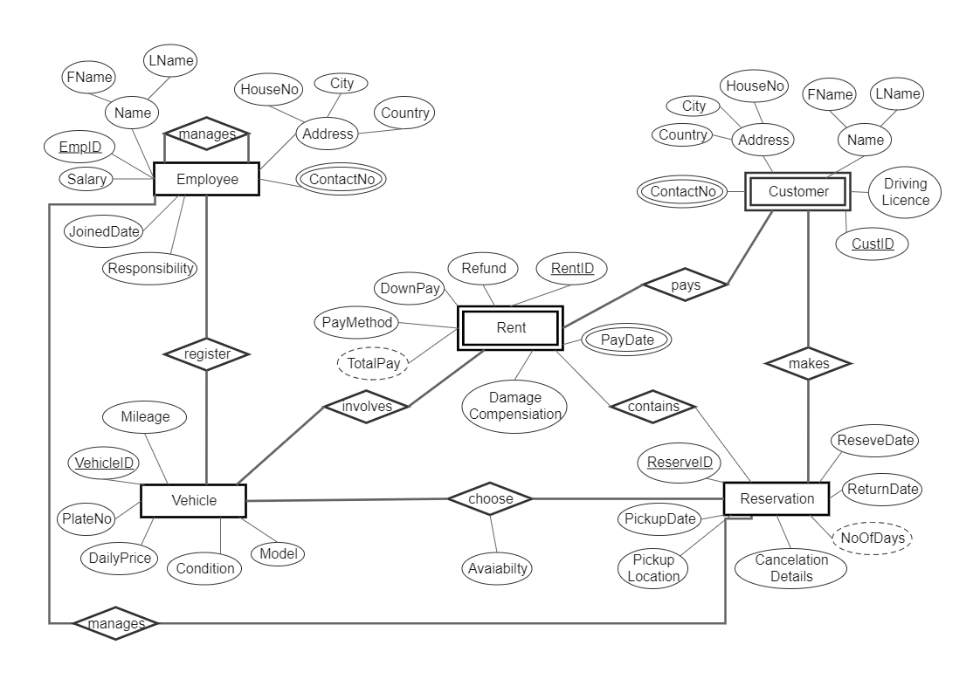
ER/EER Diagram:
The ER diagram depicts all of the relationships between entity sets in the database. It demonstrates the database's logical structure.

Slide 9
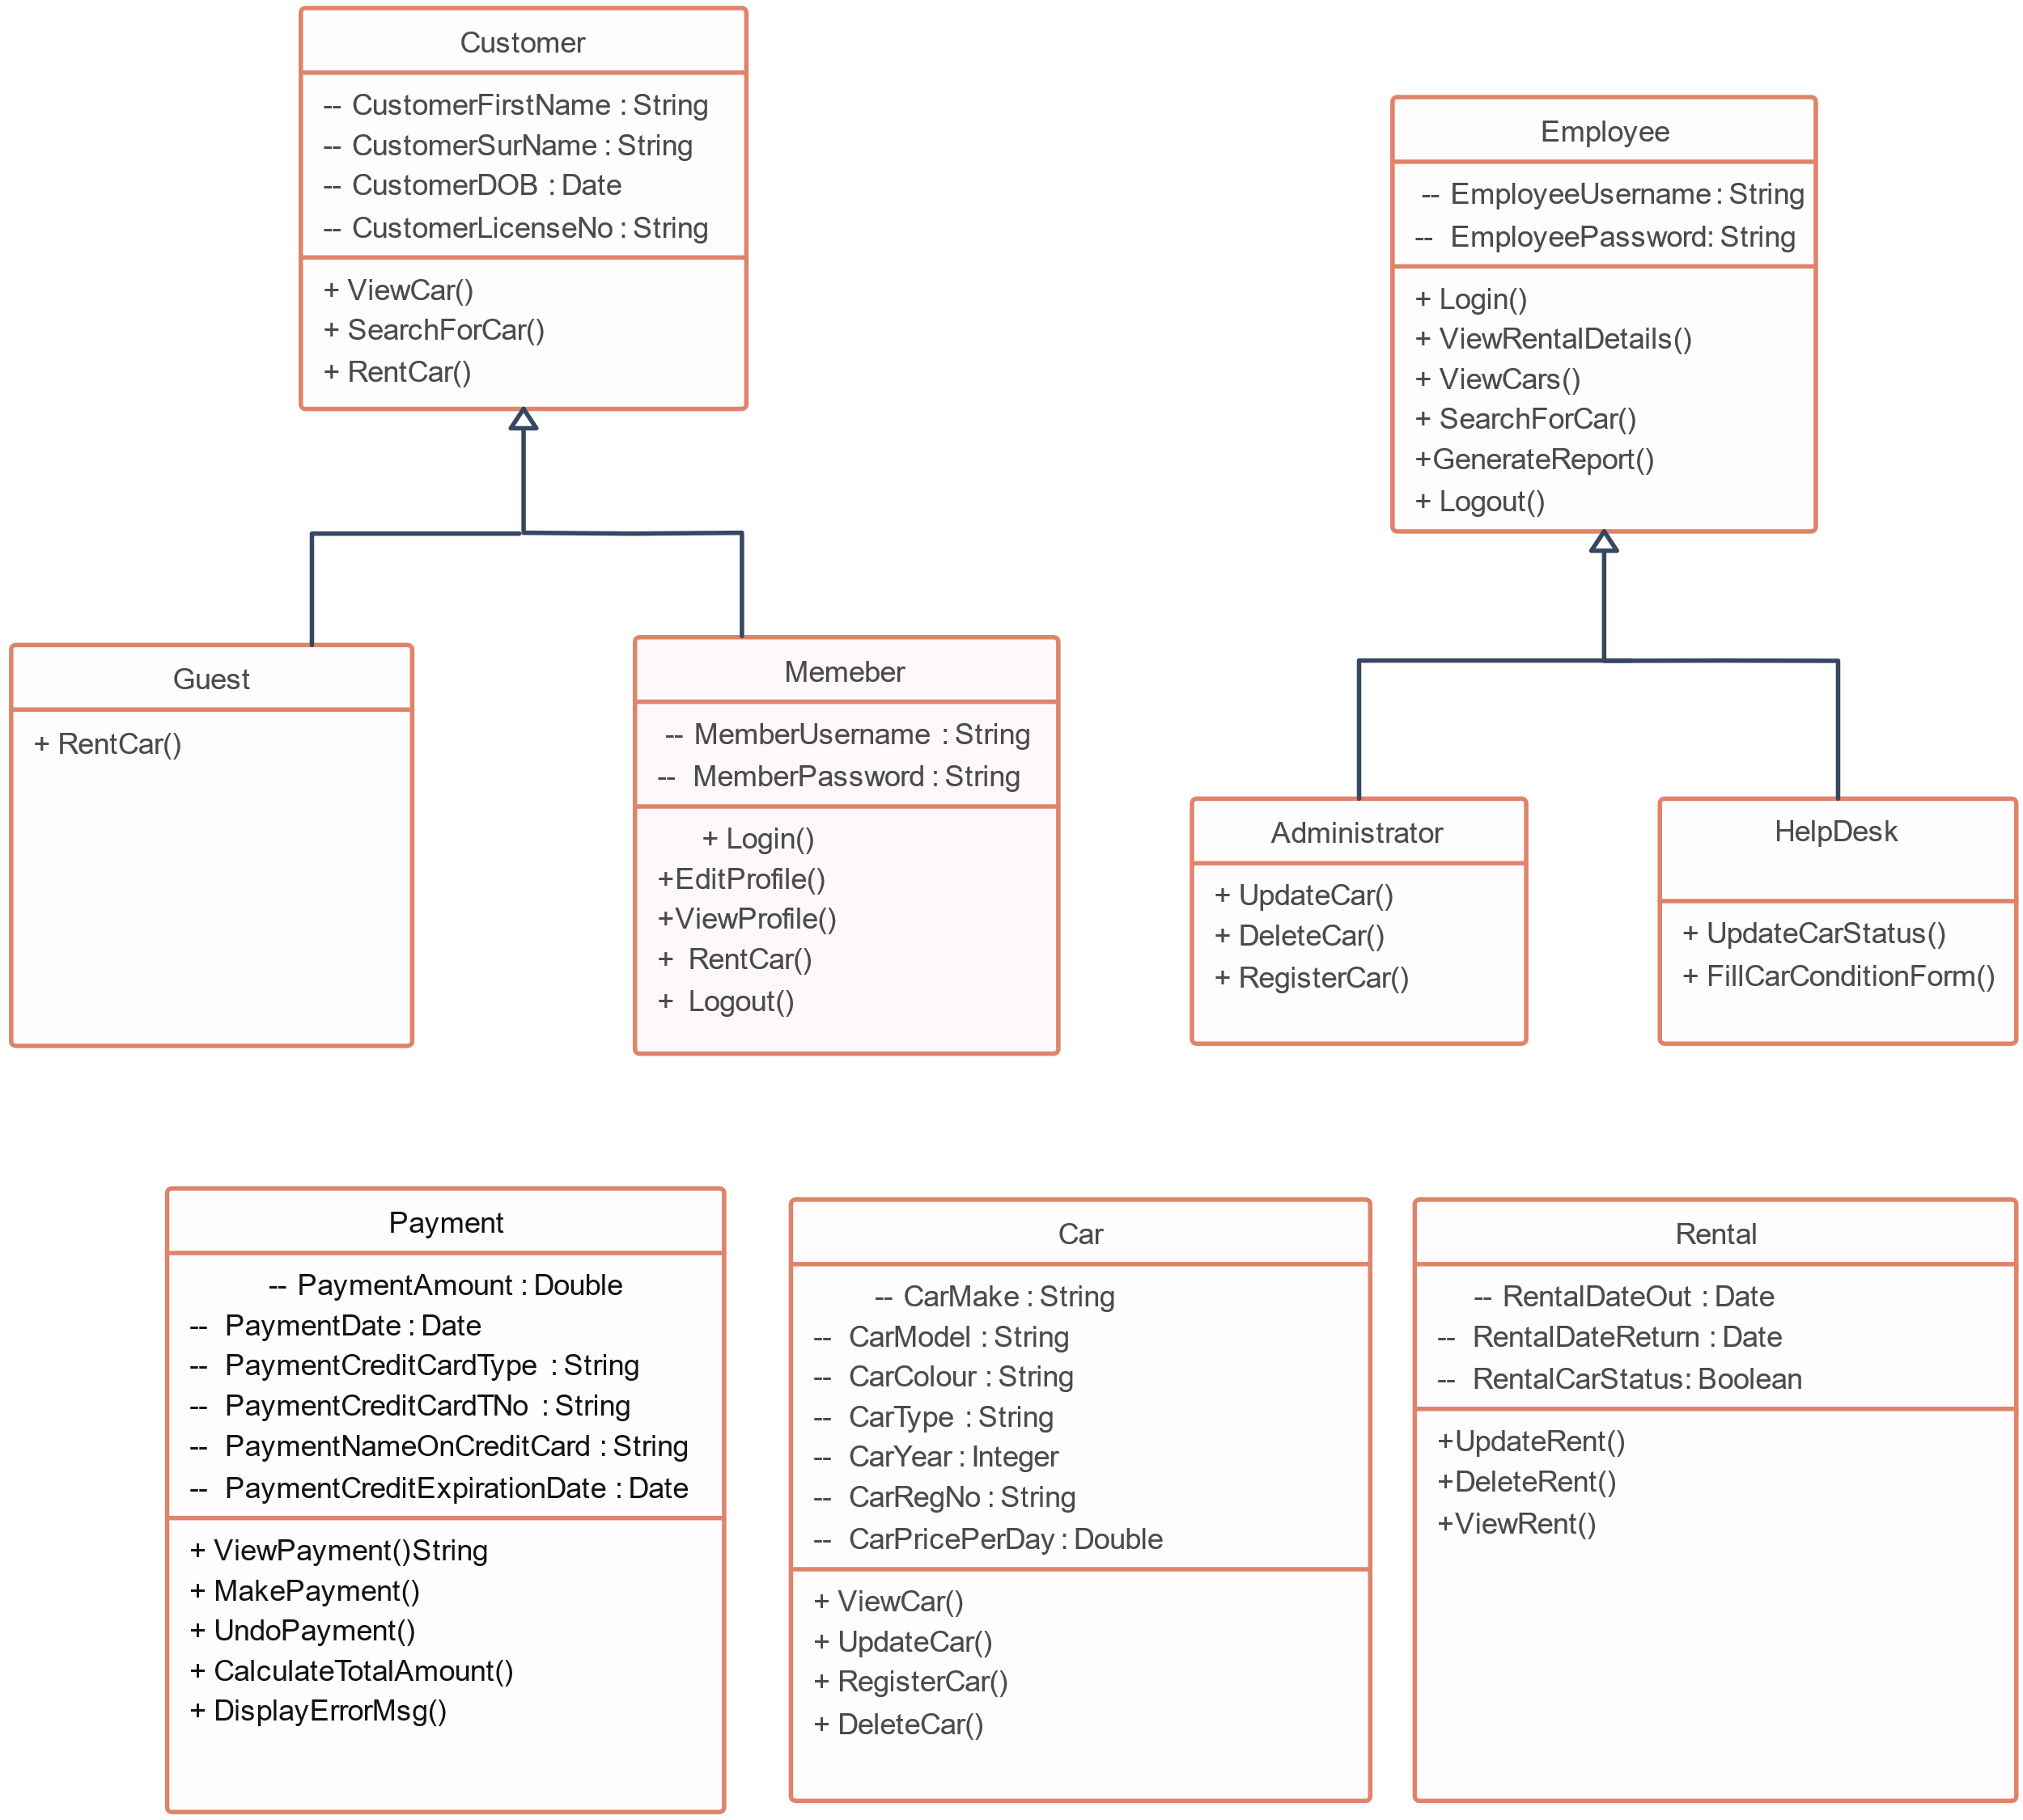
Class Diagram:
The class diagram is the main building block, a number of classes are identified and grouped together in a class diagram which helps to determine the statically relations between those objects.

Slide 10
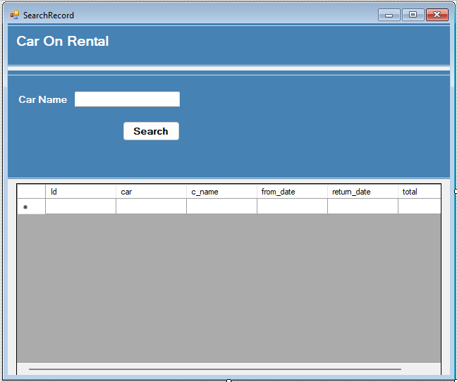
SCOPE : FUTURE SCOPE :
This project traverses a lot of areas ranging from business concept to computing field, and required to perform several researches to be able to achieve the project objectives.
In a nutshell, it can be summarized that the future scope of the project circles around maintaining information regarding:
We can add printer in future.
We can give more advance software for Car Rental System including more facilities.
We will host the platform on online servers to make it accessible worldwide.
Integrate multiple load balancers to distribute the loads of the system.
Create the master and slave database structure to reduce the overload of the database queries.
Implement the backup mechanism for taking backup of codebase and database on regular basis on different servers.

Slide 11
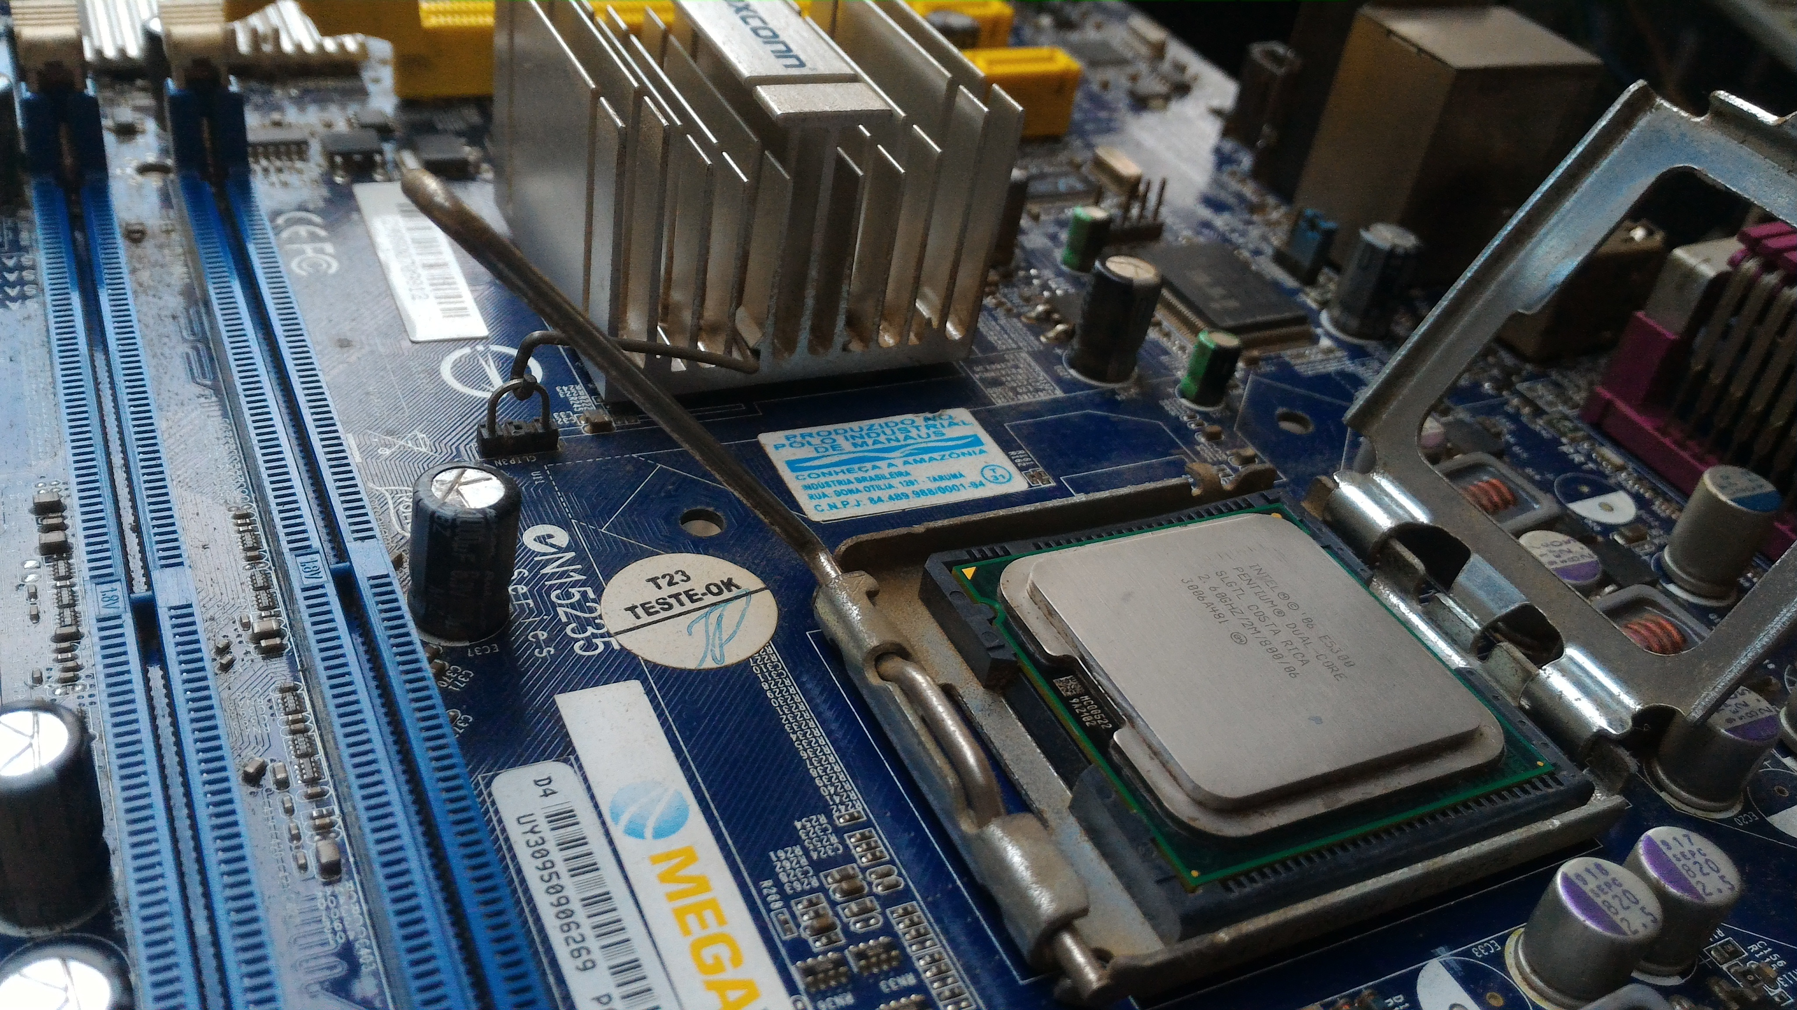
REQUIREMENTS
Software Requirements:
Hardware Requirements:
In software Requirement will use MYSQL to save data .
MySQL has built-in command prompt window to run the required commands.
It is recommended to use SQL Wave 5 which makes it easier to create, edit, update and delete MySQL databases with its powerful GUI(Graphical User Interface).
In hardware part we will suggest to use Intel core i5 Processer (center unit processor) to run web base sever .
The amount of RAM (Random Access Memory) that is required depends on many factors such as requirement to other services, frequently accessed content files, operating system paging files and the web service application.
It is recommended to have at least 1GB (Gigabyte) of RAM. Having more RAM (2GB or 4GB) in your server will be better as it will allow more files to be cached, reducing disk load.

Slide 12
LIMITATIONS
Although I have put my best efforts to make the software flexible, easy to operate but limitations cannot be ruled out even by me. Though the software presents a broad range of options to its users some intricate options could not be covered into it partly because of logistic and partly, due to lack of sophistication. Paucity of time was also major constraint, thus it was not possible to make the software foolproof and dynamic. Lack of time also compelled me to ignore some part such as storing old result of the candidate etc.

Slide 13
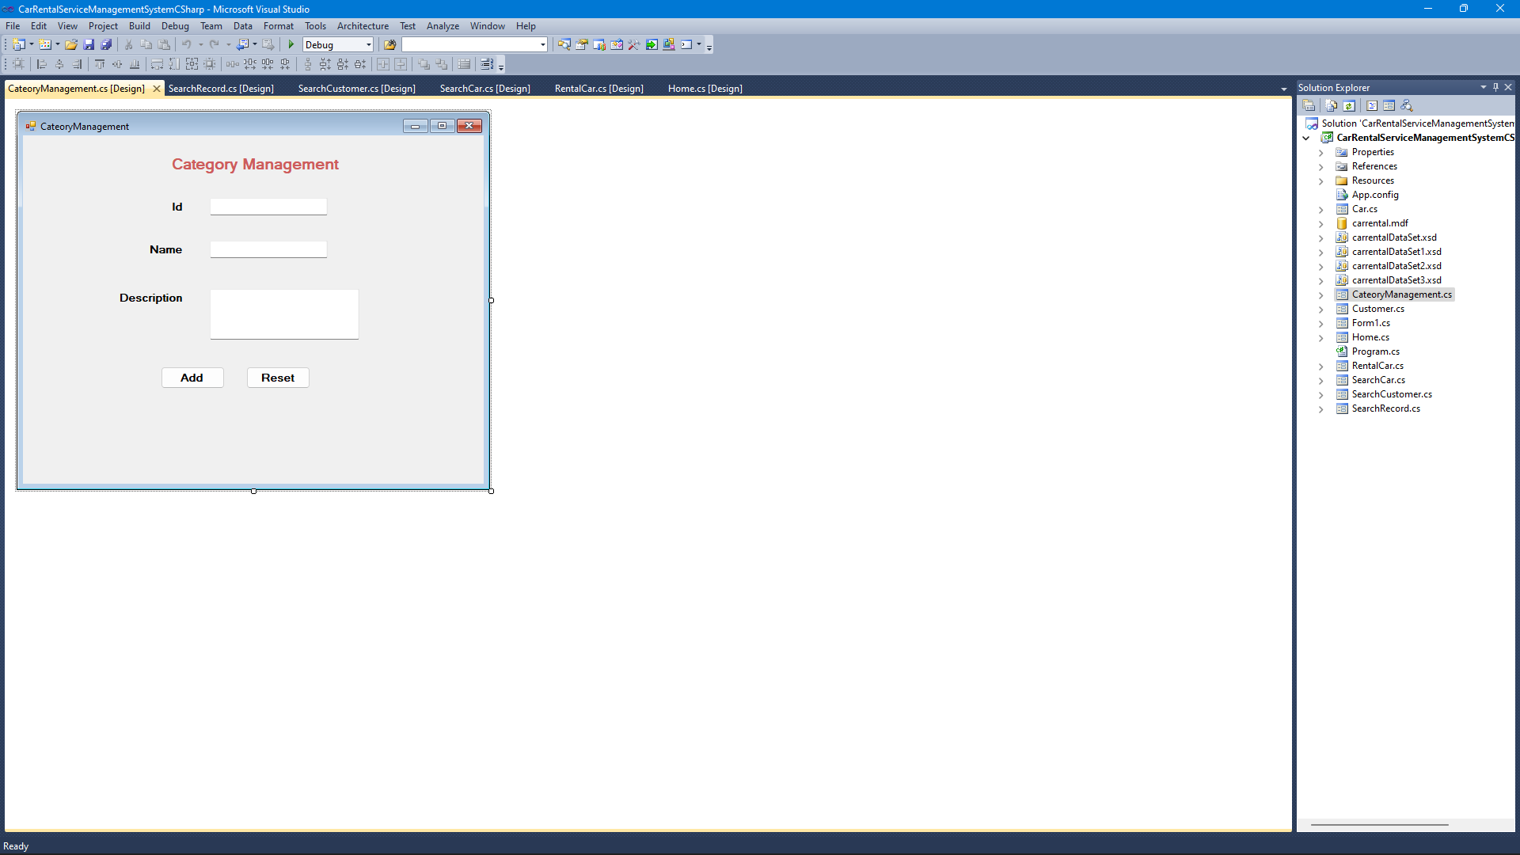
LIST OF SOME LIMITATIONS:
Excel export has not been developed for Car, Customer due to some criticality.
The transactions are executed in off-line mode, hence on-line data for Payment, Booking capture and modification is not possible.
Off-line reports of Car, Insurance, Payment cannot be generated due to batch mode execution.

Slide 14
CONCLUSION
Our project is only a humble venture to satisfy the needs to manage their rental work. Several user friendly UI have also adopted. This package shall prove to be a powerful package in satisfying all the requirements of the system. The objective of software planning is to provide a frame work that enables the manger to make reasonable estimates made within a limited time frame at the beginning of the software project and should be updated regularity as the project progresses.
At the end it is concluded that we have made efforts on following points :
A description of the background and context of the project and its relation to work already done in the area.
Made statement of the aims and objectives of the project.
The description of Purpose, Scope, and applicability.

Slide 15
REFERENCES
https://www.academia.edu
www.flightslogic.com
https://www.altexsoft.com/blog/car-rental-reservation-system
https://www.researchgate.net/publication

Slide 16
Thanking You
22742 Kavita Kotia
22743 Rohan Mistry
22744 Malaika Raut

